Slide 1
phase 2
Environment Dashboard
Team 20: Bin Sun Xiaofei Xie Peng Guo

Slide 2
CONTENTS
Sequence diagrams
domain model
design model
design patterns

Slide 3
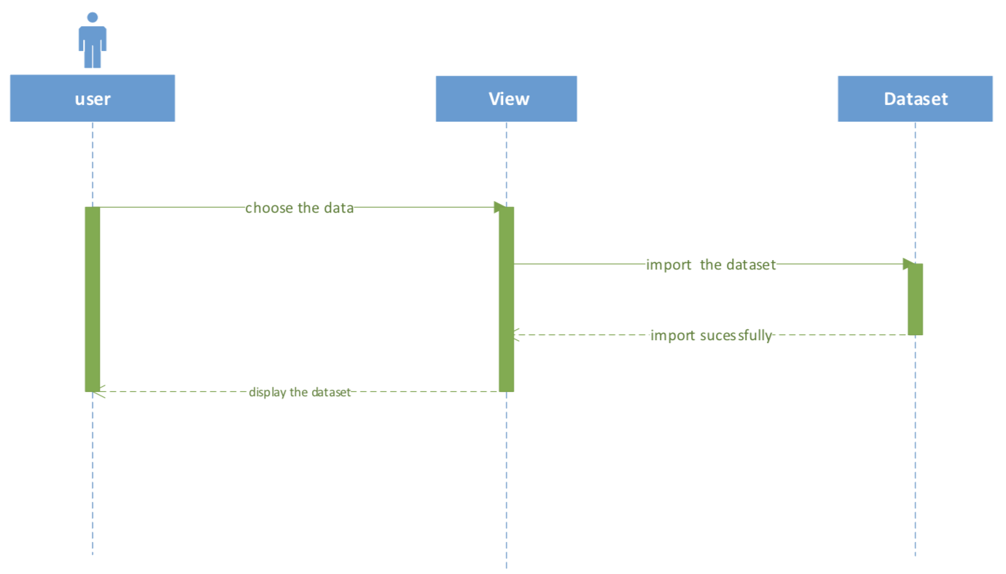
Sequence Diagram1

Slide 4
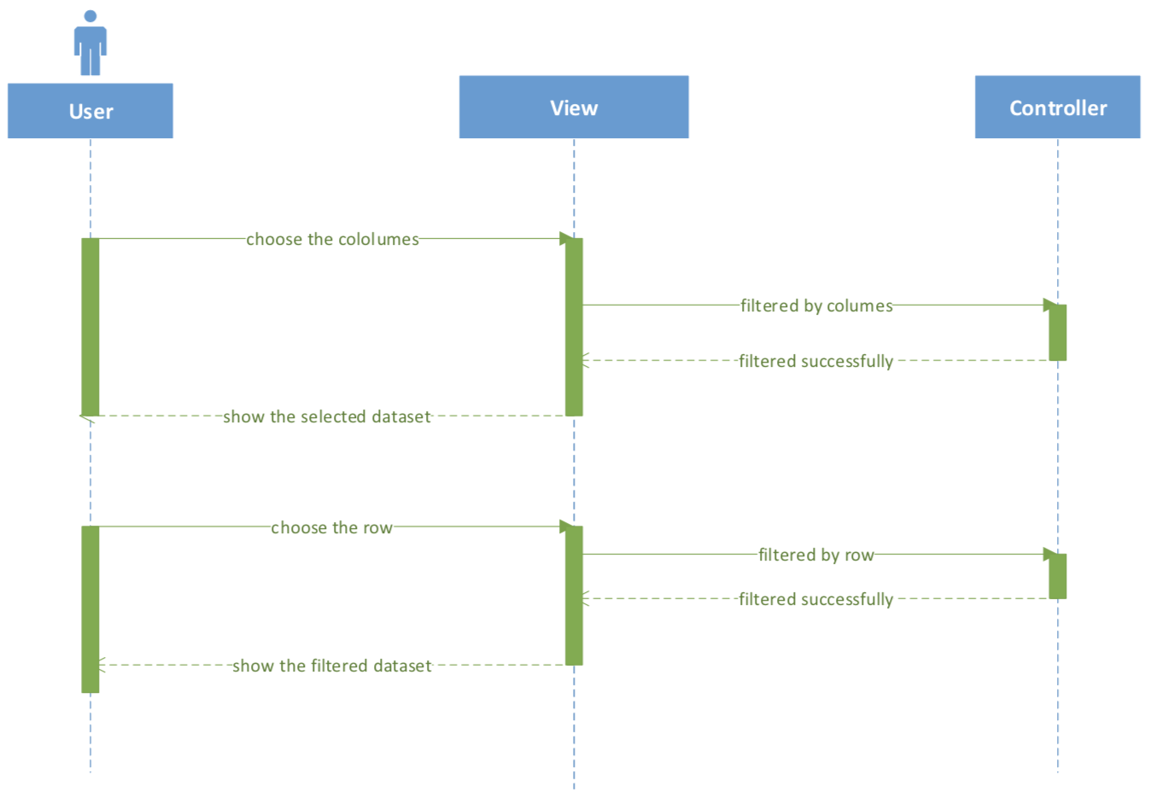
Sequence Diagram2

Slide 5
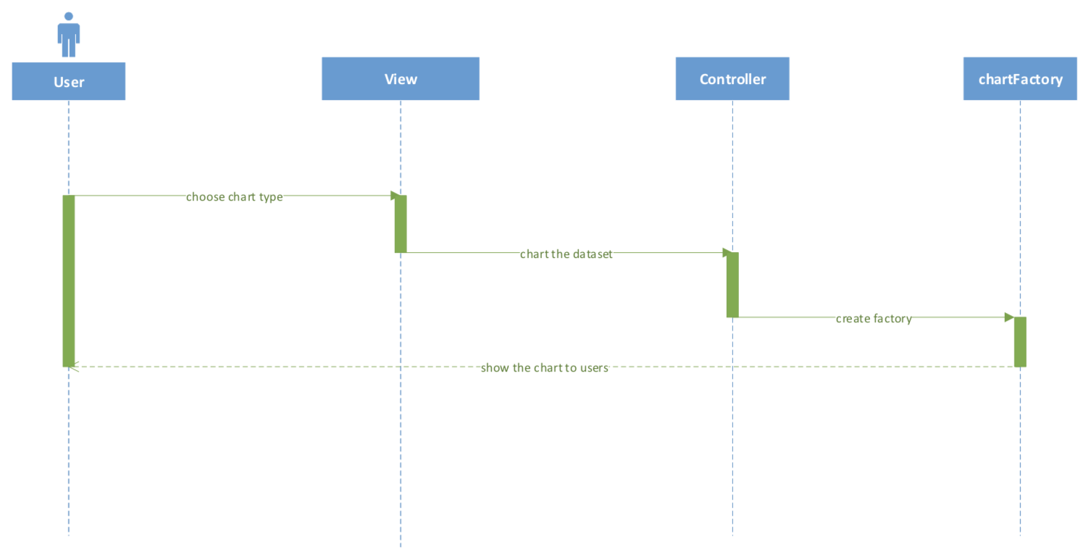
Sequence Diagram3

Slide 6
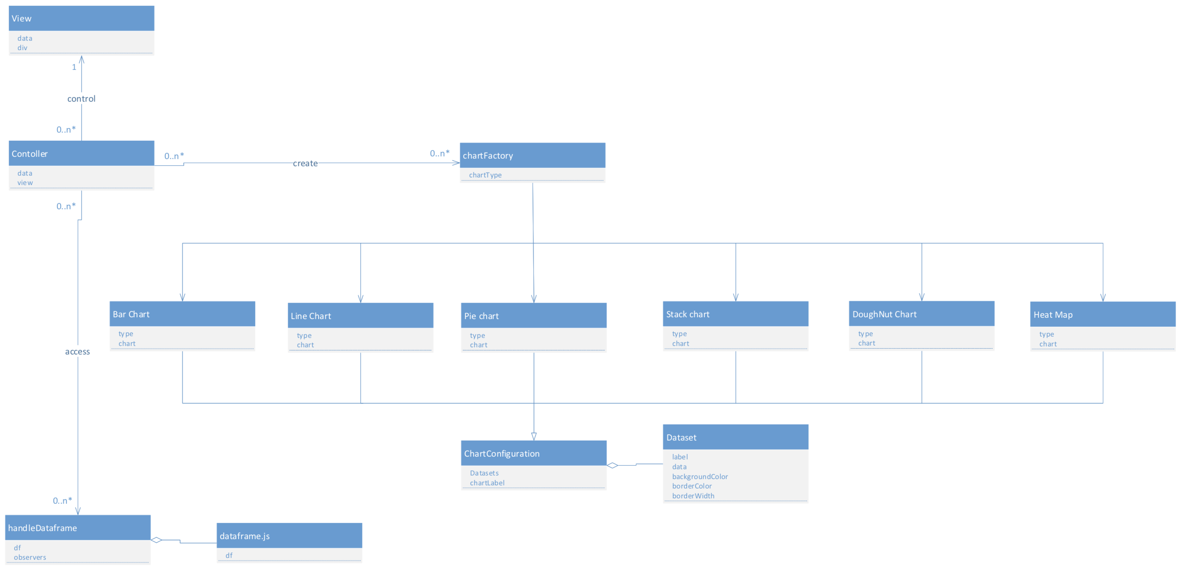
domain model

Slide 7
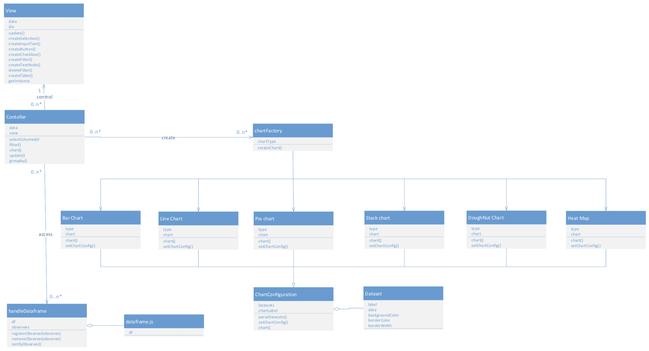
design model

Slide 8
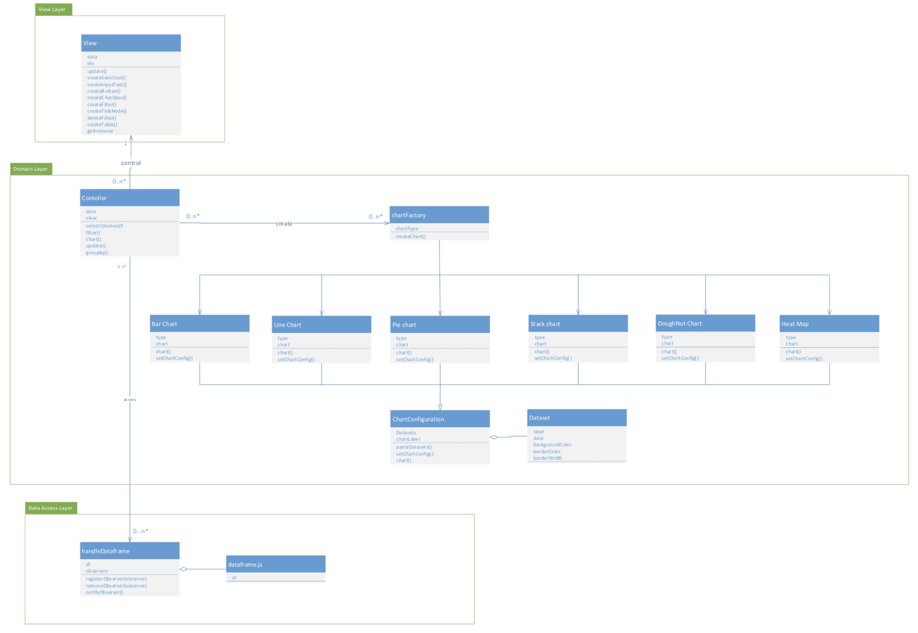
design pattern 1 : MVC

Slide 9
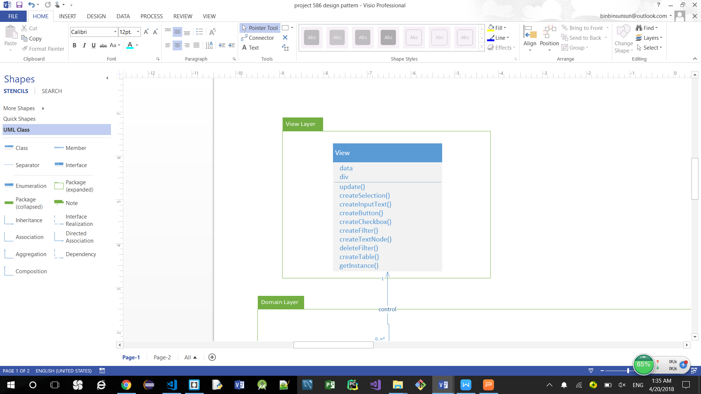
design pattern 2
singleton design pattern
The private constructor view can only called by the method getInstance(), this method will judge whther the view exist, and the view could be created only once.

Slide 10
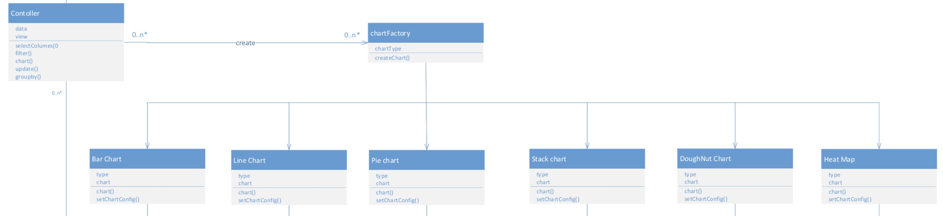
design pattern 3
factory method design pattern

Slide 11
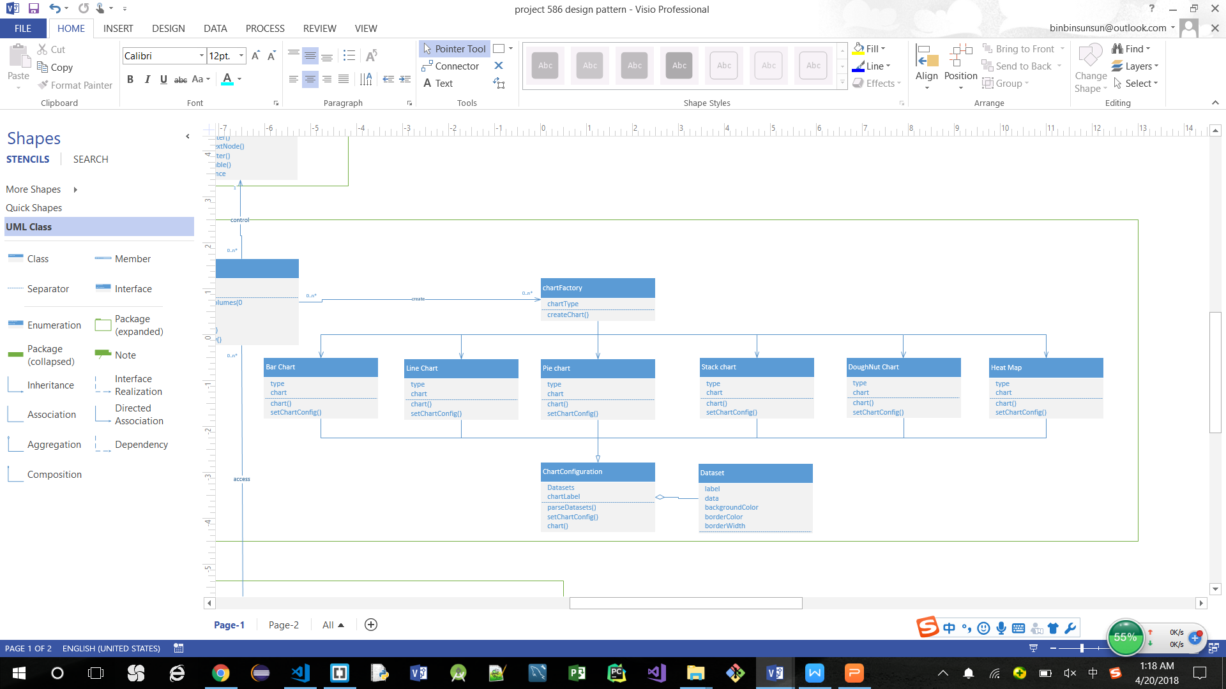
design pattern 4
template design pattern
The class ChartConfiguration defines the skeleton of operation, deferring some steps to subclasses. The method of setChartConfig(), parseData(), chart() will be defined in 5 different charts

Slide 12
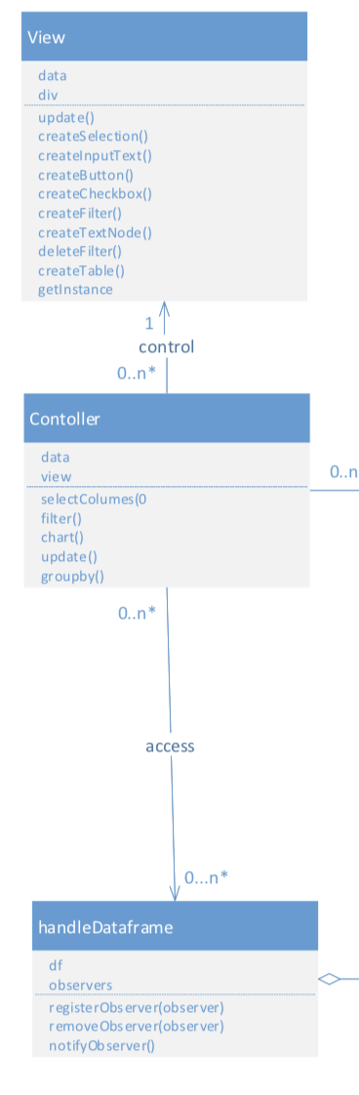
design pattern 5
observer design pattern
HandleDataFame can register others objects as observers observers notifies them automatically of any state changes, usually by calling one of their update() methods. Both View and Controller can be updated after calling the notifyObservers method

Slide 13
Dataset Reference
1.Air Quality Survey in Minneapolis
https://www.kaggle.com/gregnetols/minneapolis-air-quality-survey
2.Car Emissions data
https://www.kaggle.com/dananos/car-emissions-data/data
3. Shanghai PM2.5 Air Pollution
https://www.kaggle.com/team-ai/shanghai-pm25-air-pollution-historical-data/data
4. U.S. Pollution Data
https://www.kaggle.com/sogun3/uspollution
5.Trend Analysis of Air Pollution in USA
https://www.kaggle.com/pmw9440/trend-analysis-of-air-pollution-in-u-s-a/data
Toxic Armories
https://www.kaggle.com/prokopyev/armories/data

